Slide 1

Codecademy Data Visualization Project

Slide 2
Project Outline
Twitch is the world leading live streaming platform for gamers
This presentation showcases my results from a project set by Codecademy’s Data Science course on their user data
The project uses a 800,000-row dataset provided by Twitch containing streaming data from its users on 1st January 2015
My workflow comprised of two stages:
Analyse the dataset using SQL queries + export results
Visualize the data using Python and Matplotlib

Slide 3
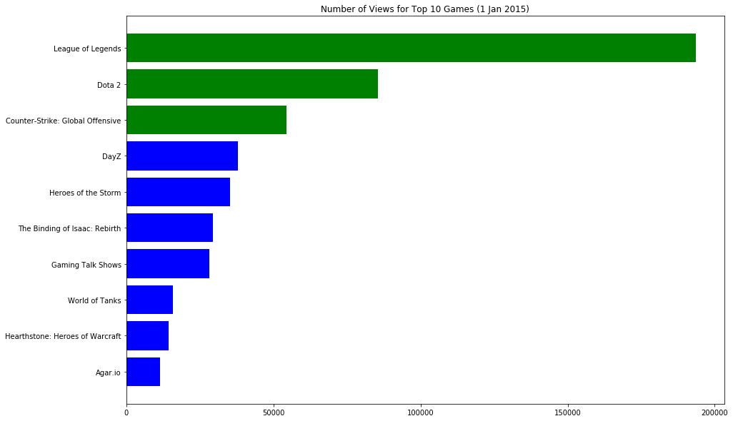
Top 10 Trending Games
Top 3 games streamed were League of Legends, Dota 2 and Counter-Strike: Global Offensive
Top 3 games were streamed over 50,000 times
10th most popular game, Agar.io, reached ~10,000 streams

Slide 4
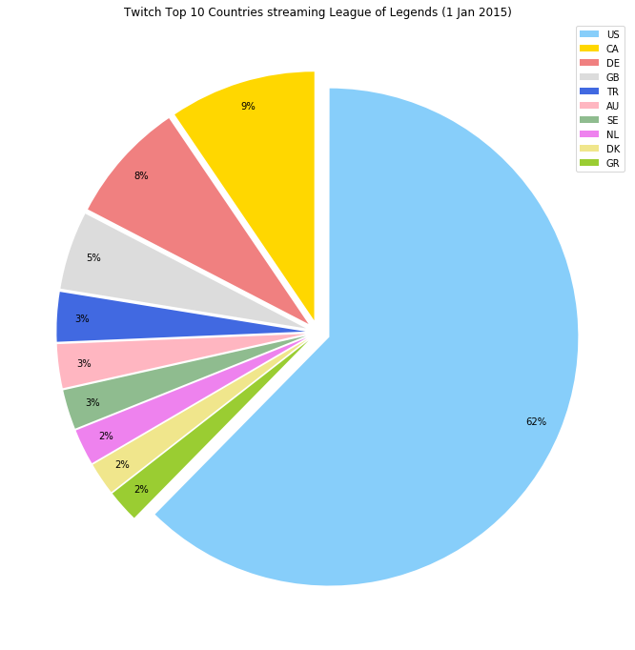
Top 10 Countries Streaming League of Legends
United States far outweighs the next most LOL-loving country, Canada
Canada, Germany and the UK take up reasonably large segments between 5% and 9%
Remaining top 10 countries contribute 3% or less

Slide 5
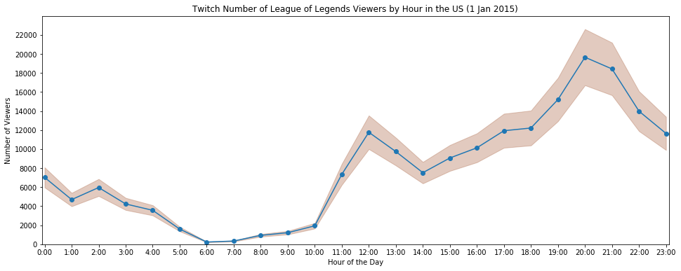
Number of LOL Streamers by hour
Many Twitch LOL streamers seem to sleep between the hours of 4am and 11am
Usage picks up around 12pm and remains relatively steady throughout the afternoon
Heaviest usage of the site peaks around 8-9pm at a rate of ~20,000 streams p/h
Sadly, it seems that over 7000 US citizens were not watching any (real) fireworks on New Years Eve!

